Slide 1

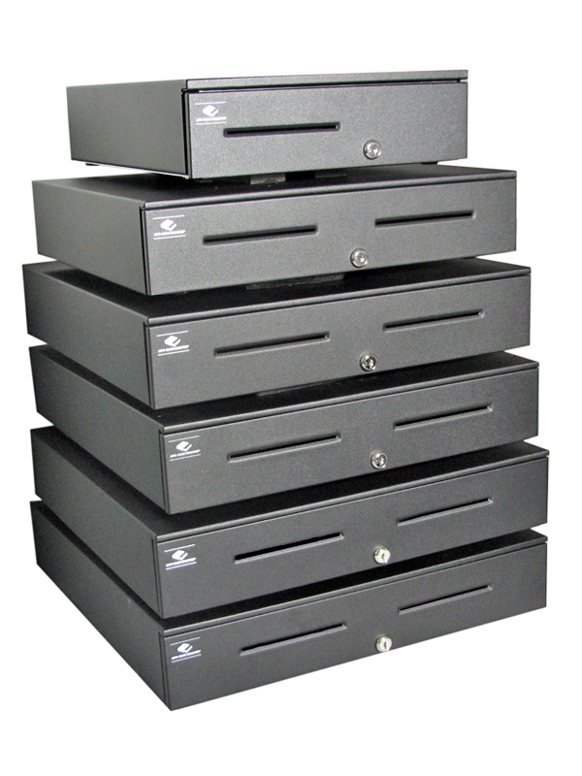
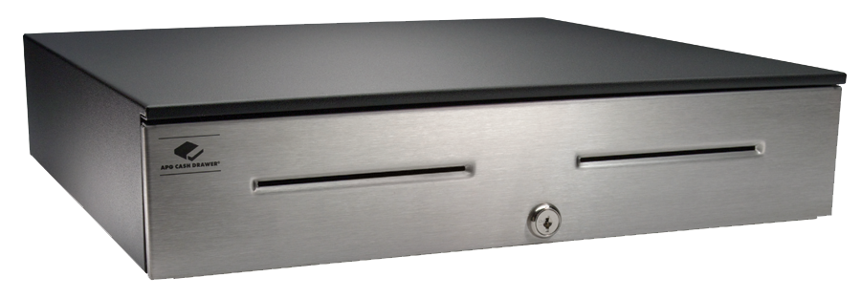
Series 4000 Cash Drawer
Product Durability: Good | Better | Best

Slide 2
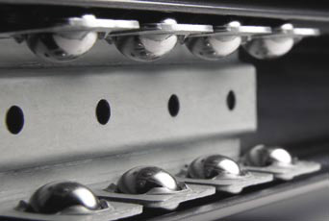
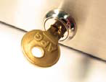
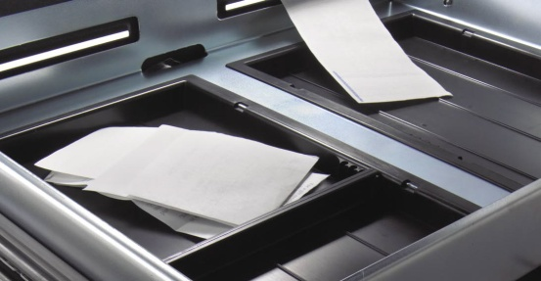
Series 4000 Cash Drawer
Product Durability: Good | Better | Best
Features:
Sizes range from 13” x 17” to 20” x 21”
“18.8” x 21” and 20” x 21” sizes provide hidden cable routing
The ultimate, rugged heavy duty cash drawer
The inner drawer has two separated media storage locations and bill storage
Tested to last beyond 4 million transactions
All steel construction and industrial grade steel ball bearing slides
Available with a variety of tills for different currencies, interfaces and integration options
Lifetime limited warranty (Online registration required, non OEM)
Major OEM customers include Oracle, PAR, TGCS, NCR, HP and Wincor

Slide 3
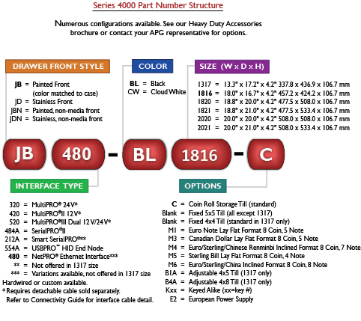
Series 4000 Cash Drawer
Product Durability: Good | Better | Best

Slide 4


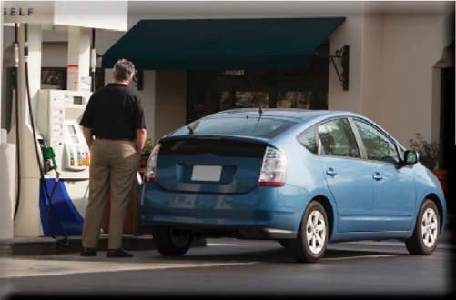
Series 4000 Cash Drawer Verticals
Product Durability: Good | Better | Best
Multiple sizes to fit a wide range of applications
Any application requiring a robust cash drawer
High volume hospitality
Drive Through
DIY and Warehouse Clubs
Lottery
Convenience Stores
Grocery
Automotive parts and services
Quick Lube

Slide 5

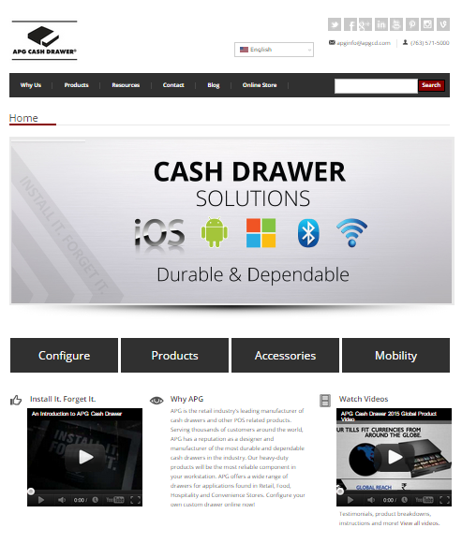








Contact Us – APG Cash Dawer, LLC
Connect with us:
APG’s mobile-friendly website:
www.cashdrawer.com
Email:
Phone:
Address:
sales@us.cashdrawer.com
763-571-5000
APG Cash Drawer, LLC
5250 Industrial Blvd. N.E.
Minneapolis, MN 55421
Tweet, Like, and Watch Us:
@APGCashDrawer
/APGCashDrawer
+APG Cash Drawer
/apgcashdrawer
/company/apg-cash-drawer
APG Cash Drawer
/apgcashdrawer
www.cashdrawer.com/blog
/APGCashDrawer
Notes:
*Presenter ADD your contact info

