Slide 1

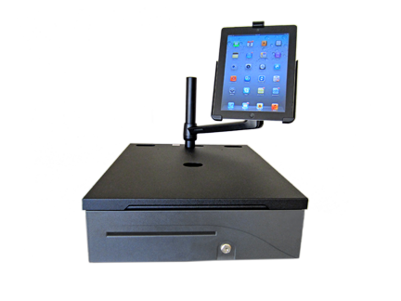
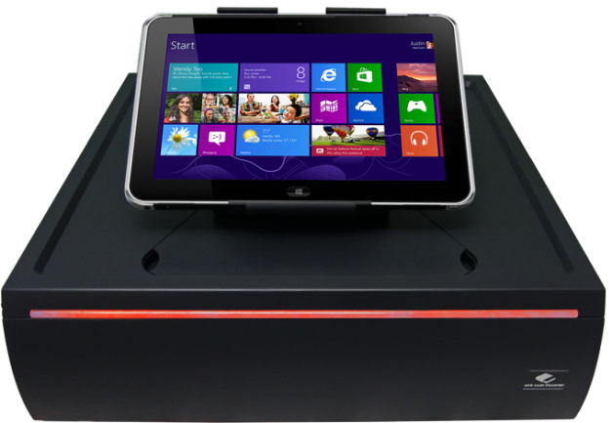
Integration Systems
Integration Products Key Benefits:
Ergonomics
Hidden Cable routing and storage
Power supply storage
Organization of components
Provides integration
Remove clutter
Added value to the cash drawer

Slide 2
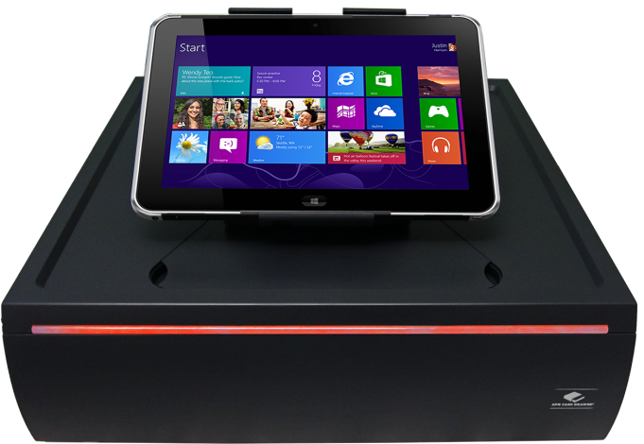
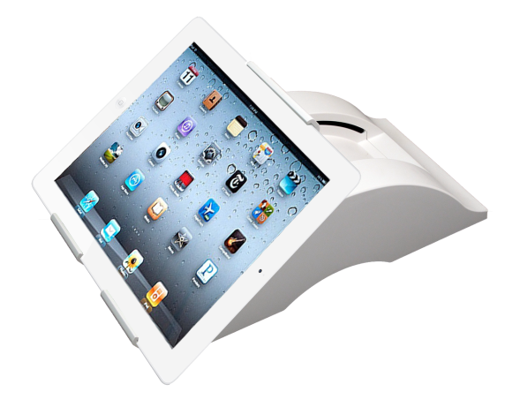

Stratis™ Integration System
Features:
The Stratis™ holder enables a tablet to seamlessly slide over to the customer facing side for signature approvals
Tablet agnostic solution. Adjustable tablet holder fits tablets between 6.6” and 8.5”
Magnetic base keeps the tablet holder firmly in place
on top of the cash drawer
Push button release makes for easy transition between thin and mobile tablet use
Cash Drawer includes USB power port for easy powering of your tablet under cable cover. Optional LED lighting also available
Tablet can be placed in either portrait or landscape mode
Cabling is hidden with dual cable routing channels for both the tablet and printer
(*Cash Drawer and Table Holder Sold Separately*)

Slide 3
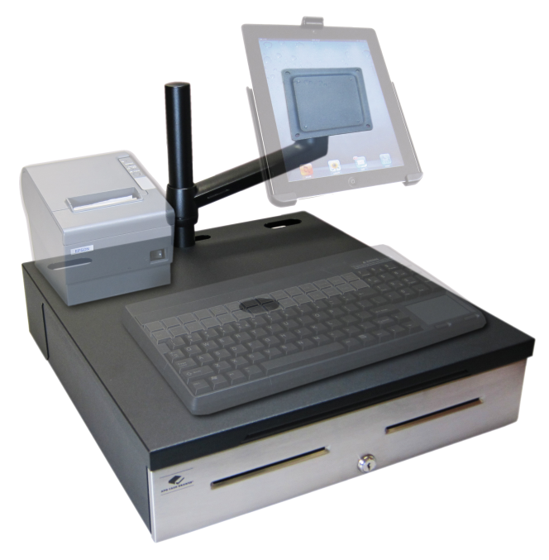
Caddy™ SPM Organizer System
Features:
Fits Series 100 (16 x 16) or
Series 4000 (18 x 16) cash drawers
Sleek and streamlined, the Caddy™ SPM cleans up
your work space cabling
Allows for ambidextrous positioning of your LCD display,
tablet, and peripherals for greater productivity
POS integration and organization
Monitor Arm supports up to 20” LCD screen (20 lbs)
Standard 75 mm and 100 mm VESA mounting

Slide 4
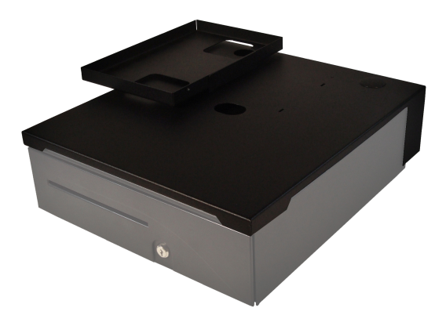
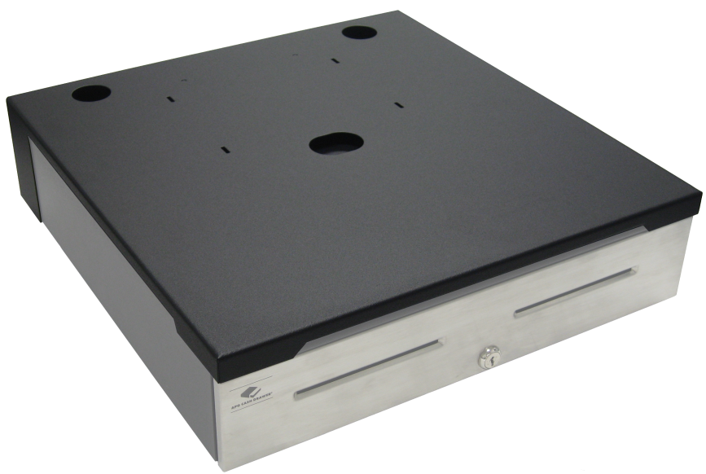
Caddy™ SP (Slim Profile) Organizer
Features:
The Caddy SP is a slim profile integration product that works with any standard Series 100 (16 x 16) or Series 4000 (18 x 16) cash drawer
Color matched to your APG cash drawer, the Caddy™ SP hides cables from sight without adding bulk
Rugged steel construction with a powder coat finish
Allows for optional left or right hand printer tray attachment to extend the work surface
Cable routing holes allow for easy cable routing
Slim profile integration, just 0.5 inches tall

Slide 5
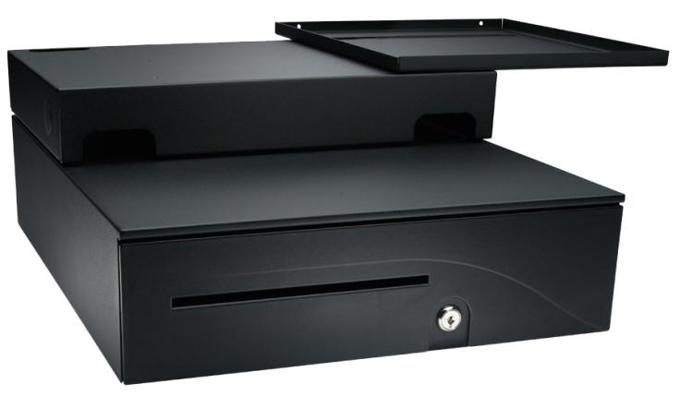
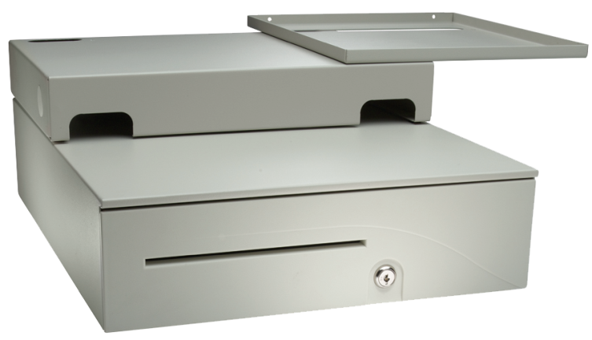
POS-Integrator™ System
Features:
A compact integration product that eliminates clutter
by organizing POS peripherals into an attractive, compact workstation
Adjusts to fit your workstation space requirements
Ambidextrous printer tray
Provides cable management to route and hide
the peripheral cables
Provides sturdy foundation to support
POS peripherals.
Fits the Series 100 16 x 19.5 drawer

Slide 6

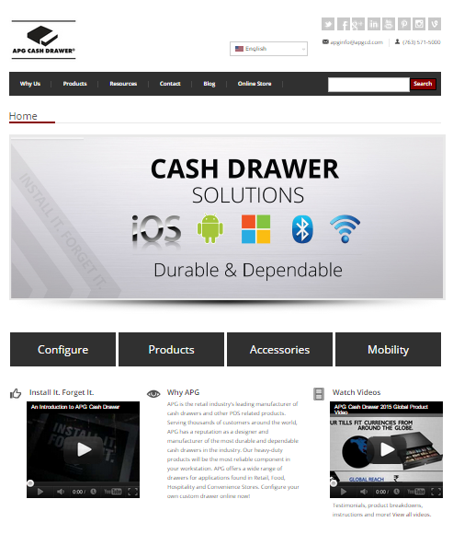








Contact Us – APG Cash Dawer, LLC
Connect with us:
APG’s mobile-friendly website:
www.cashdrawer.com
Email:
Phone:
Address:
sales@us.cashdrawer.com
763-571-5000
APG Cash Drawer, LLC
5250 Industrial Blvd. N.E.
Minneapolis, MN 55421
Tweet, Like, and Watch Us:
@APGCashDrawer
/APGCashDrawer
+APG Cash Drawer
/apgcashdrawer
/company/apg-cash-drawer
APG Cash Drawer
/apgcashdrawer
www.cashdrawer.com/blog
/APGCashDrawer
Notes:
*Presenter ADD your contact info

